Slide 1
Car Detection
with YOLO5 & FLASK APP
Group Members:
Nguyễn Duy Đạt - duydattqta13@gmail.com
Nguyễn Ngọc Minh Thy - minhthy1016@gmail.com
Nguyễn Trần Đăng Dương - duong05102002@gmail.com

Slide 2
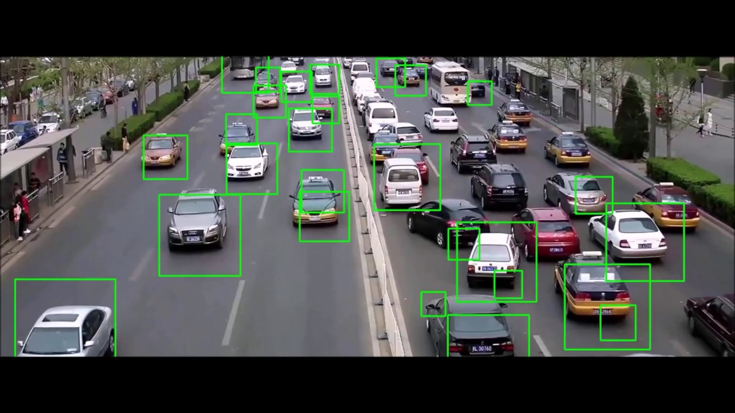
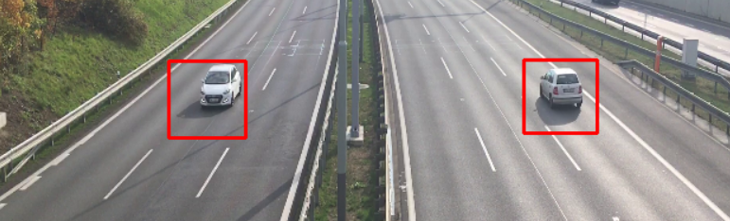
Problem Statement
Car Detection is fascinating project in Computer Vision, whether you are working in self-driving car industry, or a newbie in CV.
We want to present our experiment with YOLO5 model and build an app in Flask.

Slide 3
Data Source
Car Dataset :The dataset contains media of cars in all views.
Application idea in Flask: Detect a random vehicle from an image or video from dataset and web cam.

Slide 4
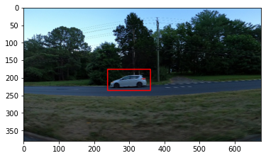
Headlines
Exploratory Data Analysis (EDA)
Experiment with YOLO5
Experiment with FLASK APP

Slide 5
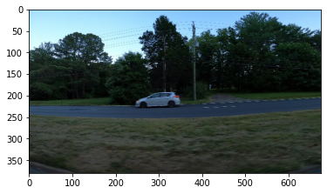
Key results
Exploratory Data Analysis (EDA)
Annotation check : with CV2 to check bounding boxes in images, we can then tag pixel-perfect precisely car position in the picture.
this step help to avoid overfitting model. The quality of these annotations define the accuracy and reliability of our model.

Slide 6
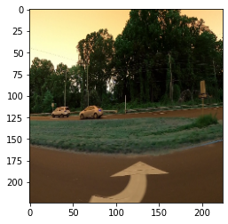
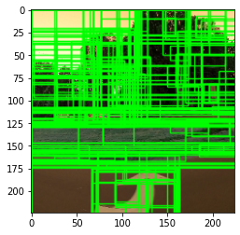
Key results
Exploratory Data Analysis (EDA)
Selective Search for Object Recognization: seeks to merge together the superpixels to find regions of an image that could contain an object.
By using Selective Search, we can more efficiently examine regions of an image that likely contain an object and then pass those regions on to a SVM, CNN, YOLO,etc. for final classification. But it is not end-to-end object detection.
Notes:
References: https://pyimagesearch.com/2020/06/29/opencv-selective-search-for-object-detection/
https://medium.com/dataseries/understanding-selective-search-for-object-detection-3f38709067d7

Slide 7
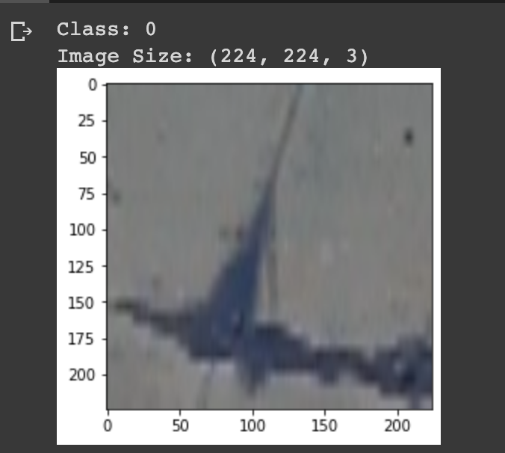
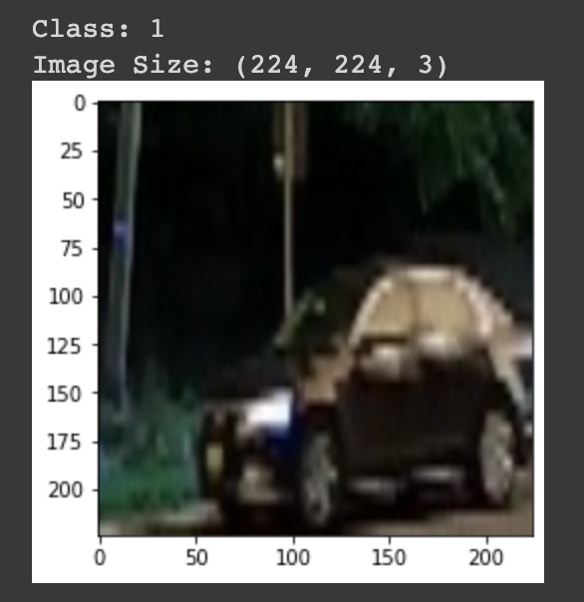
Key results
Exploratory Data Analysis (EDA)
Selective Search crop the image with IOU >0.5: we calculate IOU, use Selective Search to crop image that could contain an object with its IOU >0.5.
Then we call random list of images to check, the result will return Class of Image (Class = 1: Car) and the object location in the picture.
Notes:
References: https://pyimagesearch.com/2020/06/29/opencv-selective-search-for-object-detection/
https://medium.com/dataseries/understanding-selective-search-for-object-detection-3f38709067d7

Slide 8
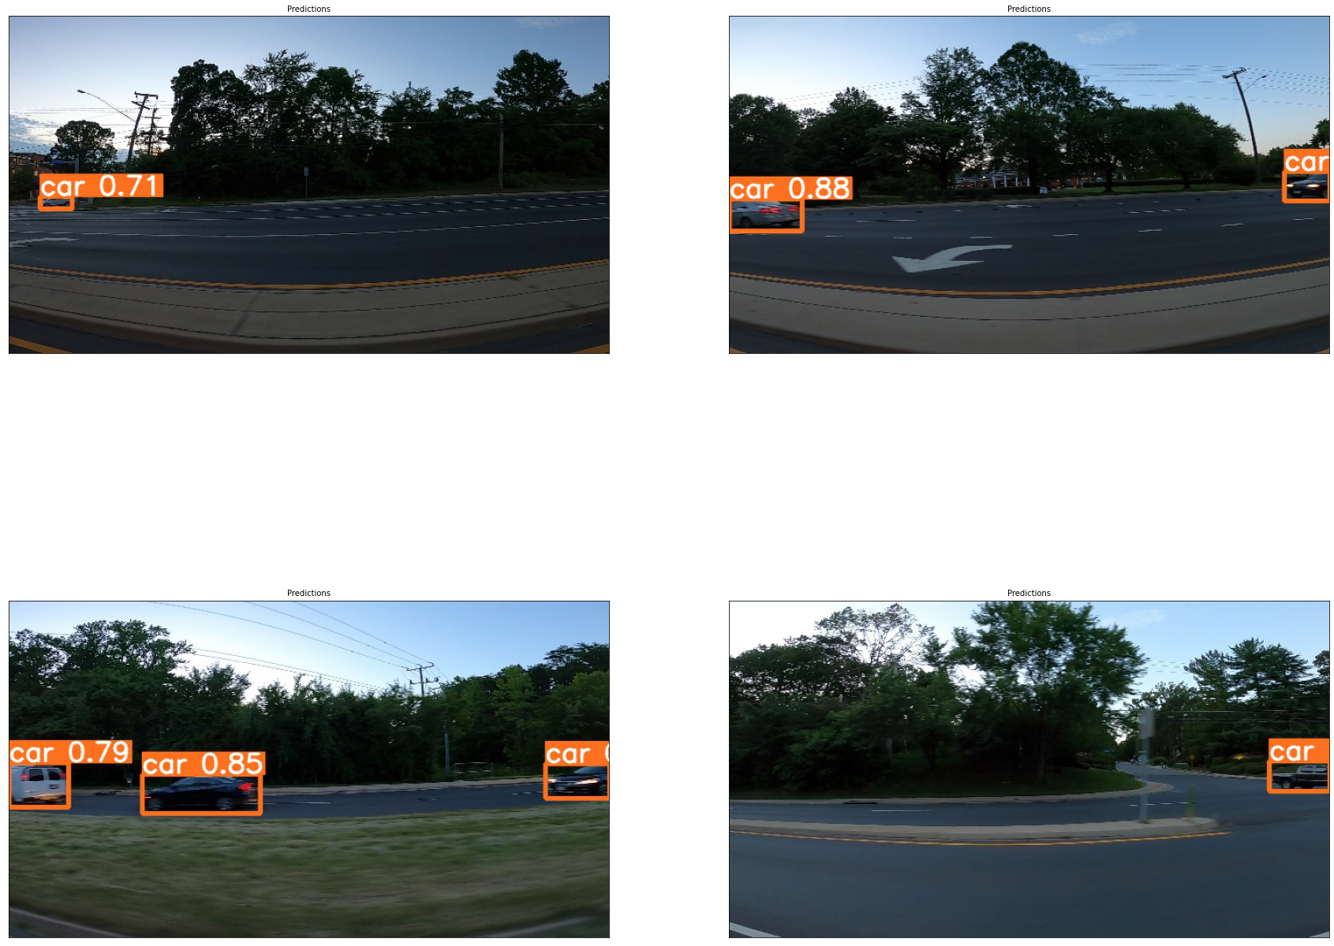
Key results
2. Experiment with YOLO5: YOLO5 is highly effective model to detect objects with high accuracy return.

Slide 9
Key results
3. Experiment with FLASK: Use YoloV5
To get all bboxxes of train dataset into XML file (annotation_dir), we use the tool :https://www.makesense.ai/. You can also try https://github.com/tzutalin/labelImg

Slide 10
Key results
3.. Experiment with FLASK
We save the model file and deploy on Flask App
You can clone the files and give it a try!

Slide 11
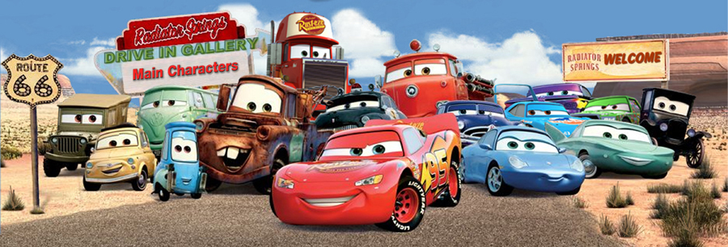
THANK YOU!!!

